Slide 1
Kubernetes Fundamental
Minh Tran
06-2022

Slide 2
Introduction To Kubernetes And Container
Virtual Machines
Containers
The Essence of Linux Container Technology
K8s Introduction
An Overview Of Kubernetes
Setting up Kubernetes
Components Overview
Kubernetes Architecture
Build Small App
Amazon Elastic Kubernetes Service (EKS)

Slide 3
01
Introduction To Kubernetes And Container

Slide 4
Virtual Machines
A Virtual Machine (VM) is a compute resource that uses software instead of a physical computer to run programs and deploy apps

Slide 5
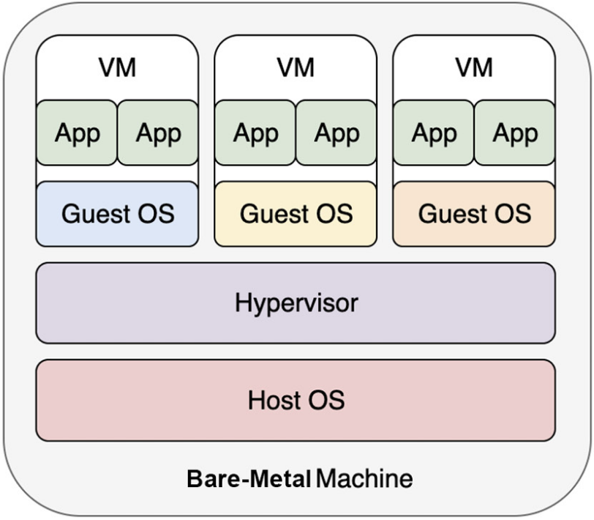
Virtual Machines
One or more virtual “guest” machines run on a physical “host” machine.
Each virtual machine runs its own operating system and functions separately from the other VMs, even when they are all running on the same host.
Virtual machine technology is used for many use cases across on-premises and cloud environments.
Advantages of VMs:
Run multiple OS environments on a single physical computer, saving physical space, time and management costs.
Support legacy applications, reducing the cost of migrating to a new operating system
VMs can also provide integrated disaster recovery and application provisioning options.
Notes:
For example, a Linux virtual machine running a distribution of Linux as the guest operating system can exist on a host server that is running a non-Linux operating system, such as Windows.

Slide 6
Virtual Machines (2)
Disadvantages of VMs:
Running multiple virtual machines on one physical machine can result in unstable performance if infrastructure requirements are not met.
Virtual machines are less efficient and run slower than a full physical computer.
5 types of virtualization
Hardware virtualization (server virtualization)
Software virtualization: Allows employees to access centrally hosted applications when working remotely.
Storage virtualization: Consolidating multiple. Physical storage devices to appear as a single storage device. Help with disaster recovery planning.
Network virtualization: Multiple sub-networks can be created on the same physical network.
Desktop virtualization: Allowing users to access their desktops from anywhere on any device.
Notes:
For example, a Linux virtual machine running a distribution of Linux as the guest operating system can exist on a host server that is running a non-Linux operating system, such as Windows.

Slide 7
Containers
A container is a standard unit of software that packages up code and all its dependencies so the application runs quickly and reliably from one computing environment to another.

Slide 8
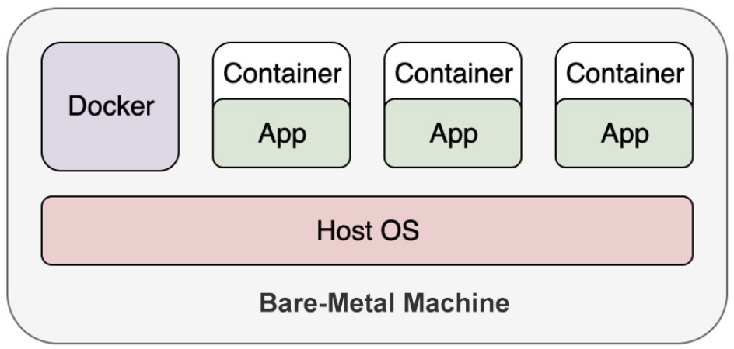
Containers
Containers were popularized by Docker and enabled a revolution in the way in which developers package and deploy their applications
Kubernetes is a container orchestrator to understand Kubernetes, it’s important to understand what we mean when we say container
In reality, a container is made up of two different pieces, and a group of associated features. A container includes:
A container image:
A set of operating system concepts that isolates a running process or processes
When we spin up a container, we don't need to bring up an entire OS; instead, it leverages the features of the Linux kernel on the host OS. Therefore, containers start up faster, function with less overhead, and require much less space compared to VMs
Notes:
It's worth mentioning that we put Docker beside the containers instead of between the containers and the host OS. That's because, technically, it's not necessary to have Docker Engine hosting those containers.
Docker Engine plays more of a manager role to manage the life cycle of the containers.
It is also inappropriate to liken Docker Engine to the hypervisor because once a container is up and running, we don't need an extra layer to "translate" the application operations to be understandable by the host OS

Slide 9
Container Image
The container image contains the application runtime, which consists of binaries, libraries, and other data needed to run the container.
Developer can package up their application as a container image on their development laptop.
When that image is deployed and run in a different setting, the container will behave exactly as it did on the developer’s laptop.
This portability and consistent execution in a variety of environments are among the primary values of container images.
When a container image is run, it is also executed using namespaces in the operating system
These namespaces contain the process and provide isolation for it and its peers from other things running on the machine
Each container has its own network and PID namespaces
There are many other namespaces within the kernel that separate various running containers from each other
Control groups (cgroups) allow the isolation of resource usage, like memory or CPU
Standard operating system security features, like SELinux or AppArmor, can also be used with running containers
The image format has been standardized through the Open Container Initiative (OCI) standard

Slide 10
Virtual Machines | Containers
Heavy on resource requirements | Light on resource requirements
Startup time in minutes | Startup time in milliseconds
Image is hard to make, reuse, and update | Image is easy to make, reuse, and update
Each VM runs its own OS | Containers share the host OS kernel
Extra resource overhead due to the translation by the hypervisor | Almost-native performance
Hardware-level virtualization | OS-level virtualization
Fully isolated | Process-level isolated

Slide 11
Container Orchestration
After you have a container image stored in a registry somewhere, you need to run it to create a working application.
This is where a container orchestrator like Kubernetes comes in pictures.
Kubernetes’ job is to take a group of machines that provide resources, like CPU, memory, and disk, and transform them into a container-oriented API that developers can use to deploy their containers.
Container orchestration automates the deployment, management, scaling, and networking of containers.
Container orchestration can be used in any environment where you use containers.
Can help you to deploy the same application across different environments without needing to redesign it.
Containers give your microservice-based apps an ideal application deployment unit and self-contained execution environment.

Slide 12
Container Orchestration (2)
Use container orchestration to automate and manage tasks such as:
Provisioning and deployment
Configuration and scheduling
Resource allocation
Container availability
Scaling or removing containers based on balancing workloads across your infrastructure
Load balancing and traffic routing
Monitoring container health
Configuring applications based on the container in which they will run
Keeping interactions between containers secure
Container orchestration tools provide a framework for managing containers and microservices architecture at scale: Kubernetes, Docker Swarm, and Apache Mesos, etc.
There are many container orchestration tools that can be used for container lifecycle management

Slide 13
The Essence of Linux Container Technology

Slide 14
Namespace
When a Linux system starts up, it creates a default namespace (the root namespace)
Then, by default, the processes created later join the same namespace, and, hence, they can interact with each other boundlessly.
Linux offers the namespace API to enable different processes being grouped into different namespaces so that only the processes that belong to the same namespace can be aware of each other. In other words, different groups of processes are isolated. This also explains why we mentioned earlier that the isolation of Docker is process-level.
The following is a list of the types of namespaces supported in the Linux kernel:
Mount namespaces
PID (Process ID) namespaces
Network namespaces
IPC (Inter-Process Communication) namespaces
UTS (Unix Time-sharing System) namespaces
User namespaces (since Linux kernel 3.8)
Cgroup namespaces (since Linux kernel 4.6)
Time namespaces (to be implemented in a future version of the Linux kernel)
Notes:
For example, two processes are able to view the files in the same folder, and also interact through the localhost network. This sounds pretty straightforward, but technically it's all credited to the root namespace, which connects all the processes.

Slide 15
Cgroups
By default, no matter which namespace a container joins, it can use all of the available resources of the host.
That is, for sure, not what we want when we are running multiple containers on a system; otherwise, a few containers may hog the resources shared among all the containers.
To address this, the cgroups (short for Control Groups) feature was introduced in Linux kernel version 2.6.24 onward to limit the resource usage of processes.
Using this feature, a system administrator can control the most important resources, such as memory, CPU, disk space, and network bandwidth.

Slide 16
Containerization: The Mindset Change
Keeping the core idea of a container in mind can help you while migrating any VM-based applications to container-based ones.
Basically, there are two patterns to deploy applications in containers
Several Application in One Container
This kind of implementation requires a supervisor application to launch and hold the container
And then, we can put applications into the container as child processes of the supervisor.
The supervisor has several variants:
A customized wrapper script: This needs complicated scripting to control the failures of managed applications.
A third-party tool such as supervisord or systemd: Upon application failures, the supervisor is responsible for getting it restarted.
One Application in One Container
This kind of implementation does not require any supervisor as in the previous case. In fact, the life cycle of the application is tied to the life cycle of the container.

Slide 17
The Need for Container Orchestration

Slide 18
Focusing
Container Interactions
Network and Storage
Resource Management and Scheduling
Failover and Recovery
Scalability
Service Exposure
Delivery Pipeline
Orchestrator: Putting All the Things Together

Slide 19
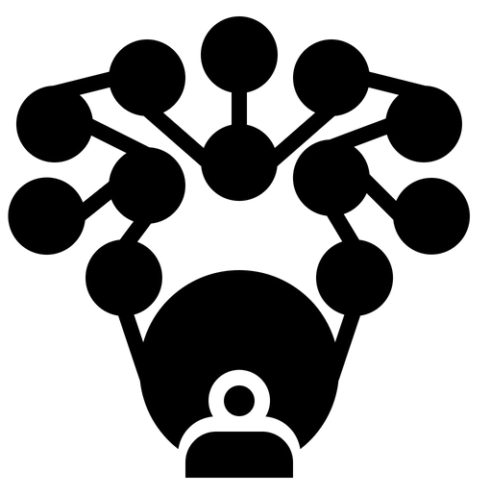
Container Interactions
Suppose that we are going to build a web app with a frontend container displaying information and accepting user requests, and a backend container serving as a datastore that interacts with the frontend container
The first challenge: how to specify the address of the backend container to the frontend container
Not a good idea to hardcode the IP, as the container IP is not static
In a distributed system, it is not uncommon for containers or machines to fail due to unexpected issues.
So, the link between any two containers must be discoverable and effective across all the machines.
The second challenge: The way to limit which containers can be visited by which kind of containers

Slide 20
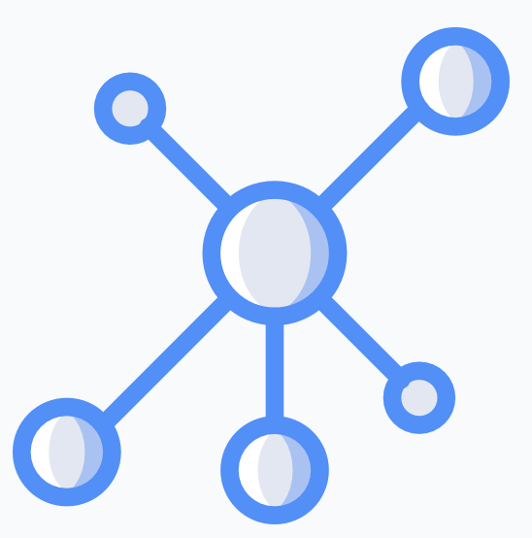
Network and Storage
If we want to run thousands of containers in production environment, we have to resolve the network connectivity issue to ensure that different containers across different machines are able to connect with each other.
Local or temporary on-disk storage doesn't always work for all workloads.
Applications may need the data to be stored remotely and be available to be mounted at will to any machine in the cluster the container is run on, no matter if the container is starting up for the first time or restarting after a failure.

Slide 21

Resource Management and Scheduling
We have seen that a container leverages Linux cgroups to manage its resource usage.
To be a modern resource manager, it needs to build an easy-to-use resource model to abstract resources such as CPU, RAM, disk, and GPU.
We need to manage a number of containers efficiently, and to provision and free up resources in time so as to achieve high cluster utilization.
Scheduling involves assigning an appropriate machine in the cluster for each of our workloads to run on.
To ensure that each container has the best machine to run, the scheduler (a Kubernetes component that takes care of scheduling) needs to have a global view of the distribution of all containers across the different machines in the cluster.
Additionally, in large data centers, the containers would need to be distributed based on the physical locations of the machines or the availability zones of the cloud services.
Notes:
For example, if all containers supporting a service are allocated to the same physical machine, and that machine happens to fail, the service will experience a period of outage regardless of how many replicas of the containers you had deployed.

Slide 22

Failover and Recovery
Application or machine errors are quite common in a distributed system. Therefore, we must consider container and machine failures.
When containers encounter fatal errors and exit, they should be able to be restarted on the same or another suitable machine that is available.
We should be able to detect machine faults or network partitions so as to reschedule the containers from problematic machines to healthy ones.
Moreover, the reconciliation process should be autonomous, to make sure the application is always running in its desired state.

Slide 23
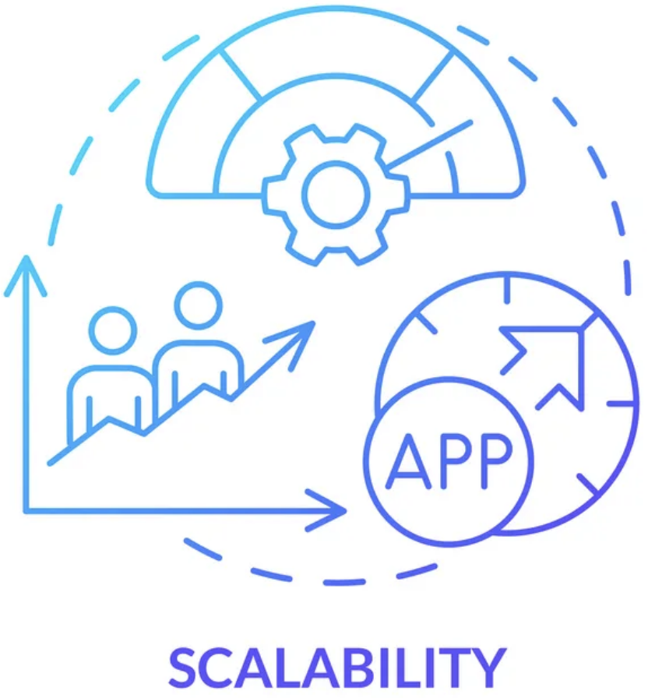
Scalability
As demand increases, you may want to scale up an application.
We may need to run several replicas of it and use a load balancer to distribute the incoming traffic evenly among the many replicas of containers supporting the service.
You may want the application to be scaled dynamically, either horizontally (by having more or fewer replicas), or vertically (by allocating more or fewer resources).

Slide 24
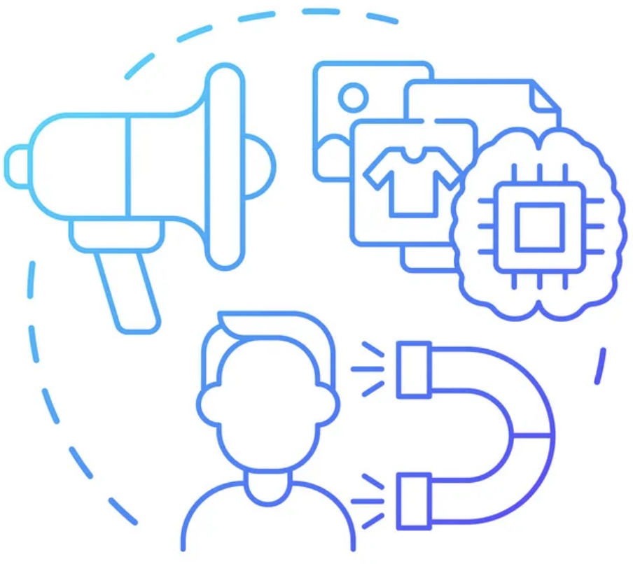
Service Exposure
Another challenge: how can the applications be accessed externally?
The external endpoint needs to be associated with the underlying on-premises or cloud environment so that it can leverage the infrastructure's API to make itself always accessible.
To keep the internal network traffic always going through, the external endpoint needs to be associated with internal backing replicas dynamically – any unhealthy replicas need to be taken out and backfilled automatically to ensure that the application remains online.
Moreover, L4 (TCP/UDP) and L7 (HTTP, HTTPS) traffic has different characteristics in terms of packets, and, therefore, needs to be treated in slightly different ways to ensure efficiency.

Slide 25
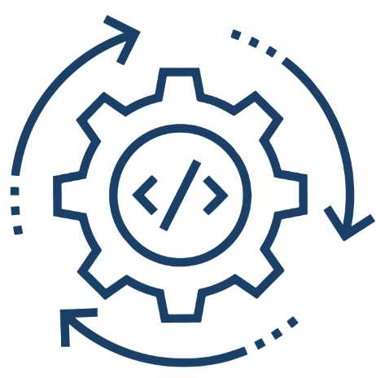
Delivery Pipeline
From a system administrator's point of view, a healthy cluster must be monitorable, operable, and autonomous in responding to failures.
This requires the applications deployed on to the cluster to follow a standardized and configurable delivery pipeline so that it can be managed well at different phases, as well as in different environments.
We need to provide several building blocks to connect the containers all together to accomplish a complicated task.

Slide 26

Orchestrator: Putting All the Things Together
In order to connect the containers to each other to accomplish the desired functionality in a scalable, high-performant, and self-recovering manner, we need a well-designed container orchestrator.
Otherwise, we would not be able to migrate our applications from VMs to containers.
It's the third reason why containerization technologies began to be adopted on a large scale in recent years, particularly upon the emergence of Kubernetes – which is the de facto container orchestrator nowadays.
Welcome to the Kubernetes World

Slide 27
K8s Introduction
"Kubernetes (K8s) is an open-source system for automating deployment, scaling, and management of containerized applications."
– kubernetes.io

Slide 28
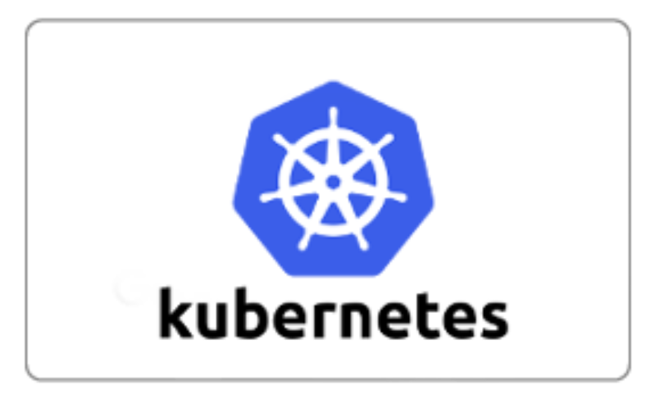
Kubernetes is Greek for pilot or helmsman (the person holding the ship’s steering wheel). People pronounce Kubernetes in a few different ways. Many pronounce it as Koo-ber-nay-tace, while others pronounce it more like Koo-ber-netties. No matter which form you use, people will understand what you mean.

Slide 29
Welcome to the Kubernetes World
Unlike typical software that usually evolves piece by piece, Kubernetes got a kick-start as it was designed based on years of experience on Google's internal large-scale cluster management software such as Borg and Omega.
That's to say, Kubernetes was born equipped with lots of best practices in the container orchestration and management field.
Concepts such as pods, one IP per pod, declarative APIs, and controller patterns, among others that were first introduced by Kubernetes, seemed to be a bit "impracticable", and some people at that time might have questioned their real value.
However, 5 years later, those design rationales remain unchanged and have proven to be the key differentiators from other software.

Slide 30
Well-known features of Kubernetes
Kubernetes resolves all the challenges mentioned in the previous section. Some of the well-known features that Kubernetes provides are:
Native support for application life cycle management
This includes built-in support for application replicating, autoscaling, rollout, and rollback
You can describe the desired state of your application (for example, how many replicas, which image version, and so on), and Kubernetes will automatically reconcile the real state to meet its desired state.
When it comes to rollout and rollback, Kubernetes ensures that the old replicas are replaced by new ones gradually to avoid downtime of the application.
Built-in health-checking support
By implementing some "health check" hooks, you can define when the containers can be viewed as ready, alive, or failed.
Kubernetes will only start directing traffic to a container when it's healthy as well as ready.
It will also restart the unhealthy containers automatically.
Service discovery and load balancing
Kubernetes provides internal load balancing between different replicas of a workload.
Since containers can fail occasionally, Kubernetes doesn't use an IP for direct access.
Instead, it uses an internal DNS and exposes each service with a DNS record for communication within a cluster.
Configuration management
Network and storage abstraction

Slide 31
Well-known features of Kubernetes (2)
Configuration management
Kubernetes uses labels to describe the machines and workloads.
They're respected by Kubernetes' components to manage containers and dependencies in a loosely coupled and flexible fashion.
Moreover, the simple but powerful labels can be used to achieve advanced scheduling features (for example, taint/toleration and affinity/anti-affinity).
In terms of security, Kubernetes provides the Secret API to allow you to store and manage sensitive information. This can help application developers to associate the credentials with your applications securely.
From a system administrator's point of view, Kubernetes also provides varied options for managing authentication and authorization.
Moreover, some options such as ConfigMaps aim to provide fine-grained mechanics to build a flexible application delivery pipeline.
Network and storage abstraction
Kubernetes initiates the standards to abstract the network and storage specifications, which are known as the CNI (Container Network Interface) and CSI (Container Storage Interface).
Each network and storage provider follows the interface and provides its implementation. This mechanism decouples the interface between Kubernetes and heterogeneous providers.
Each network and storage provider follows the interface and provides its implementation. This mechanism decouples the interface between Kubernetes and heterogeneous providers.

Slide 32
Kubernetes provide different extension mechanics
Under the hood, there are some key concepts supporting the previously mentioned features, and, more critically, Kubernetes provides different extension mechanics for end-users to build customized clusters or even their own platform
The Declarative API
The Declarative API is a way to describe what you want to be done. Under this contract, we just specify the desired final state rather than describing the steps to get there.
The declarative model is widely used in Kubernetes. It not only enables Kubernetes' core features to function in a fault-tolerant way but also serves as a golden rule to build Kubernetes extension solutions.
Concise Kubernetes core
The forerunners of Kubernetes set some baselines to keep Kubernetes' core neat and concise.
For example, instead of binding to a particular container runtime (for example, Docker or Containerd), Kubernetes defines an interface (CRI or the container runtime interface) to be technology-agnostic so that users can choose which runtime to use.
Also, by defining the CNI (Container Network Interface), it delegates the pod and host's network routing implementation to different projects such as Calico and Weave Net.
In this way, Kubernetes is able to keep its core manageable, and also encourage more vendors to join, so the end-users can have more choices to avoid vendor lock-ins.
Notes:
Concise Kubernetes core: Xúc tích K8s core

Slide 33
Kubernetes provide different extension mechanics (2)
Configurable, pluggable, and extensible design
All Kubernetes' components provide configuration files and flags for users to customize the functionalities.
And each core component is implemented strictly to adhere to the public Kubernetes API; for advanced users, you can choose to implement a part of or the entire component yourself to fulfill a special requirement, as long as it is subject to the API.
Moreover, Kubernetes provides a series of extension points to extend Kubernetes' features, as well as building your platform.
Notes:
Concise Kubernetes core: Xúc tích K8s core

Slide 34
02
An Overview Of Kubernetes

Slide 35
Setting up Kubernetes

Slide 36
Setting up K8s
As of today, based on your requirements, there are a lot of options to choose from
If you are using physical (bare-metal) servers or virtual machines (VMs), Kubeadm is a good fit.
If you're running on cloud environments, Kops and Kubespray can ease Kubernetes installation, as well as integration with the cloud providers.
If you want to drop the burden of managing the Kubernetes control plane (which we will learn about later in this chapter), almost all cloud providers have their Kubernetes managed services, such as Google Kubernetes Engine (GKE), Amazon Elastic Kubernetes Service (EKS), Azure Kubernetes Service (AKS), and IBM Kubernetes Service (IKS).
If you just want a playground to study Kubernetes in, Minikube and Kind can help you spin up a Kubernetes cluster in minutes.
In this course, we will use Docker Desktop to learn Kubernetes.
Beside that, we can learn others way to install and test K8s
https://kubernetes.io/releases/download/
https://kubernetes.io/vi/docs/tasks/tools/install-minikube/

Slide 37
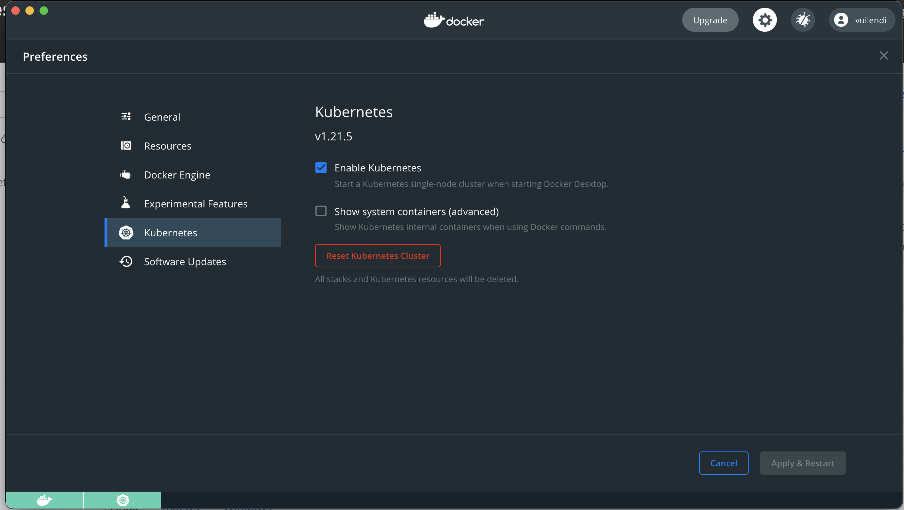
Docker Desktop
Enable Kubernetes:
Preferences > Kubernetes and then click Enable Kubernetes
This instantiates images required to run the Kubernetes server as containers, and installs the /usr/local/bin/kubectl command on your machine.
By default, Kubernetes containers are hidden from commands like docker ps, because managing them manually is not supported. To see these internal containers, select Show system containers (advanced). Most users do not need this option.
Docker Desktop does not upgrade your Kubernetes cluster automatically after a new update. To upgrade your Kubernetes cluster to the latest version, select Reset Kubernetes Cluster.

Slide 38
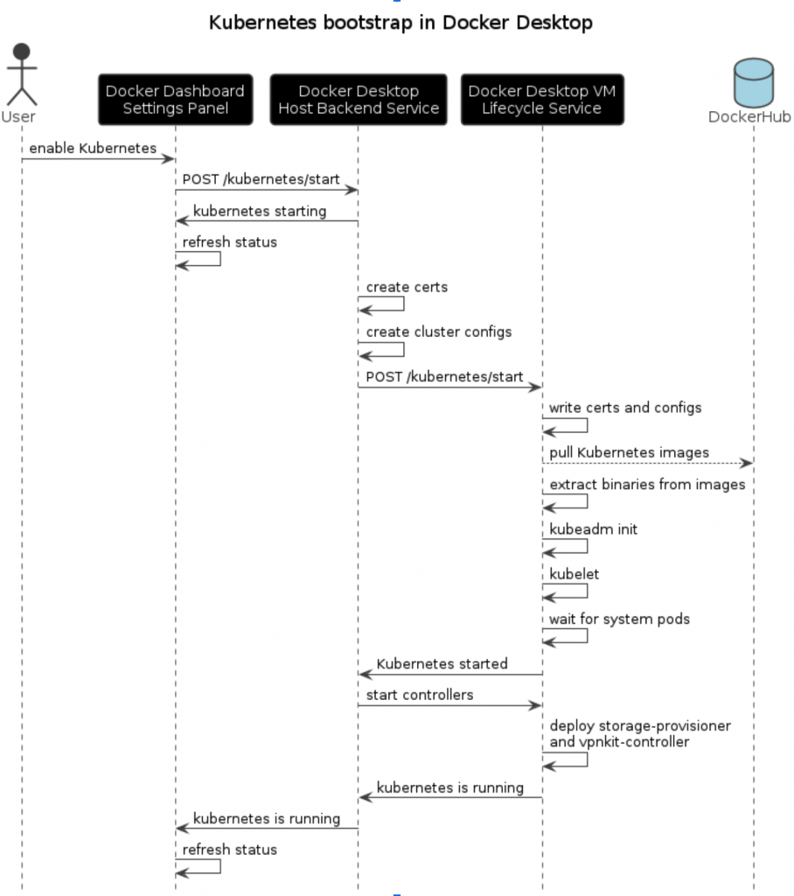

Slide 39
Use the kubectl command
If you have already installed kubectl and pointing to some other environment, such as minikube or a GKE cluster, ensure you change the context so that kubectl is pointing to docker-desktop:
Listing the available nodes:
Check that kubectl is properly configured by getting the cluster state:
$ kubectl config get-contexts
$ kubectl config use-context docker-desktop
$ kubectl get nodes
$ kubectl cluster-info
$ kubectl cluster-info dump

Slide 40
Kubernetes Components Overview

Slide 41
Kubernetes Components
When you deploy Kubernetes, you get a cluster.
A Kubernetes cluster consists of a set of worker machines, called nodes, that run containerized applications. Every cluster has at least one worker node.
The worker node(s) host the Pods that are the components of the application workload.
The control plane manages the worker nodes and the Pods in the cluster.
In production environments, the control plane usually runs across multiple computers and a cluster usually runs multiple nodes, providing fault-tolerance and high availability.

Slide 42
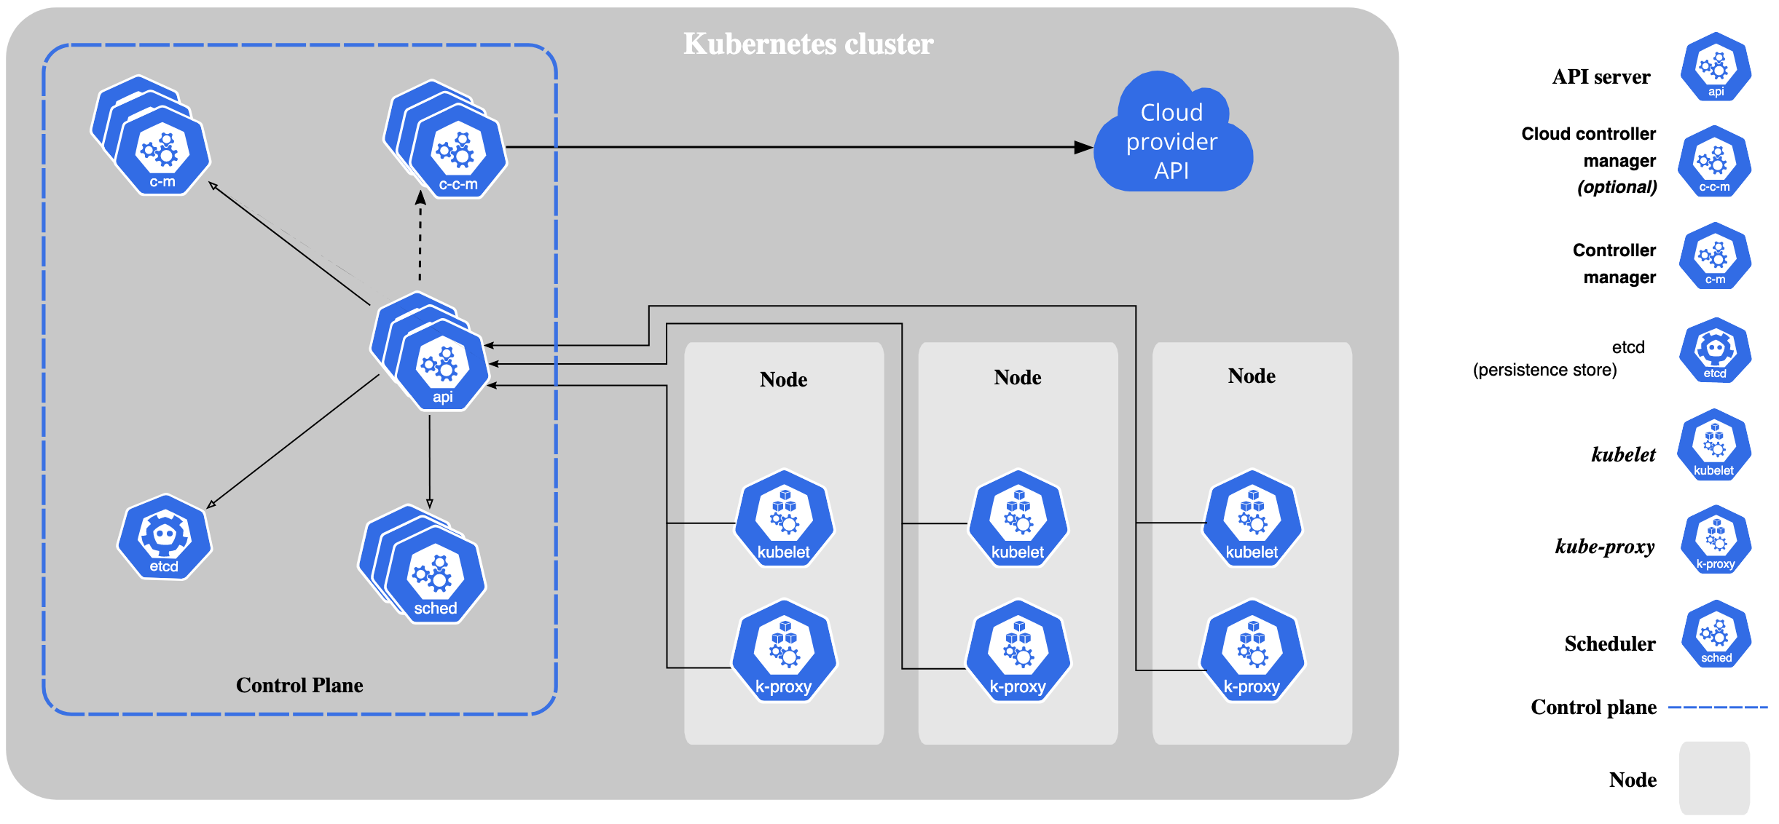

Slide 43
Control Plane Components
The control plane's components make global decisions about the cluster (for example, scheduling), as well as detecting and responding to cluster events (for example, starting up a new pod when a deployment's replicas field is unsatisfied).
Control plane components can be run on any machine in the cluster.
However, for simplicity, set up scripts typically start all control plane components on the same machine, and do not run user containers on this machine.
kube-apiserver
The API server is a component of the Kubernetes control plane that exposes the Kubernetes API.
The API server is the front end for the Kubernetes control plane.
The main implementation of a Kubernetes API server is kube-apiserver
etcd
Consistent and highly-available key value store used as Kubernetes' backing store for all cluster data.
If your Kubernetes cluster uses etcd as its backing store, make sure you have a back up plan for those data.
Notes:
kube-apiserver is designed to scale horizontally—that is, it scales by deploying more instances. You can run several instances of kube-apiserver and balance traffic between those instances.

Slide 44
Control Plane Components (2)
kube-scheduler
Control plane component that watches for newly created Pods with no assigned node, and selects a node for them to run on.
Factors taken into account for scheduling decisions include: individual and collective resource requirements, hardware/software/policy constraints, affinity and anti-affinity specifications, data locality, inter-workload interference, and deadlines.
kube-controller-manager
Control plane component that runs controller processes.
Logically, each controller is a separate process, but to reduce complexity, they are all compiled into a single binary and run in a single process.
Some types of these controllers are:
Node controller: Responsible for noticing and responding when nodes go down.
Job controller: Watches for Job objects that represent one-off tasks, then creates Pods to run those tasks to completion.
Endpoints controller: Populates the Endpoints object (that is, joins Services & Pods).
Service Account & Token controllers: Create default accounts and API access tokens for new namespaces.
Notes:
kube-apiserver is designed to scale horizontally—that is, it scales by deploying more instances. You can run several instances of kube-apiserver and balance traffic between those instances.

Slide 45
Control Plane Components (3)
cloud-controller-manager
A Kubernetes control plane component that embeds cloud-specific control logic.
The cloud controller manager lets you link your cluster into your cloud provider's API, and separates out the components that interact with that cloud platform from components that only interact with your cluster.
The cloud-controller-manager only runs controllers that are specific to your cloud provider. If you are running Kubernetes on your own premises, or in a learning environment inside your own PC, the cluster does not have a cloud controller manager.
As with the kube-controller-manager, the cloud-controller-manager combines several logically independent control loops into a single binary that you run as a single process. You can scale horizontally (run more than one copy) to improve performance or to help tolerate failures.
The following controllers can have cloud provider dependencies:
Node controller: For checking the cloud provider to determine if a node has been deleted in the cloud after it stops responding
Route controller: For setting up routes in the underlying cloud infrastructure
Service controller: For creating, updating and deleting cloud provider load balancers
Notes:
kube-apiserver is designed to scale horizontally—that is, it scales by deploying more instances. You can run several instances of kube-apiserver and balance traffic between those instances.

Slide 46
Node Components
Node components run on every node, maintaining running pods and providing the Kubernetes runtime environment.
kubelet
An agent that runs on each node in the cluster. It makes sure that containers are running in a Pod.
The kubelet takes a set of PodSpecs that are provided through various mechanisms and ensures that the containers described in those PodSpecs are running and healthy. The kubelet doesn't manage containers which were not created by Kubernetes.
kube-proxy
kube-proxy is a network proxy that runs on each node in your cluster, implementing part of the Kubernetes Service concept.
kube-proxy maintains network rules on nodes. These network rules allow network communication to your Pods from network sessions inside or outside of your cluster.
kube-proxy uses the operating system packet filtering layer if there is one and it's available. Otherwise, kube-proxy forwards the traffic itself.
Container runtime
The container runtime is the software that is responsible for running containers.
Kubernetes supports container runtimes such as containerd, CRI-O, and any other implementation of the Kubernetes CRI (Container Runtime Interface).

Slide 47
Addons
Addons use Kubernetes resources (DaemonSet, Deployment, etc) to implement cluster features. Because these are providing cluster-level features, namespaced resources for addons belong within the kube-system namespace.
DNS
While the other addons are not strictly required, all Kubernetes clusters should have cluster DNS, as many examples rely on it.
Cluster DNS is a DNS server, in addition to the other DNS server(s) in your environment, which serves DNS records for Kubernetes services.
Containers started by Kubernetes automatically include this DNS server in their DNS searches.
Web UI (Dashboard)
Dashboard is a general purpose, web-based UI for Kubernetes clusters. It allows users to manage and troubleshoot applications running in the cluster, as well as the cluster itself.
Container Resource Monitoring
Container Resource Monitoring records generic time-series metrics about containers in a central database, and provides a UI for browsing that data.
Cluster-level Logging
A cluster-level logging mechanism is responsible for saving container logs to a central log store with search/browsing interface.

Slide 48
Kubernetes Architecture

Slide 49
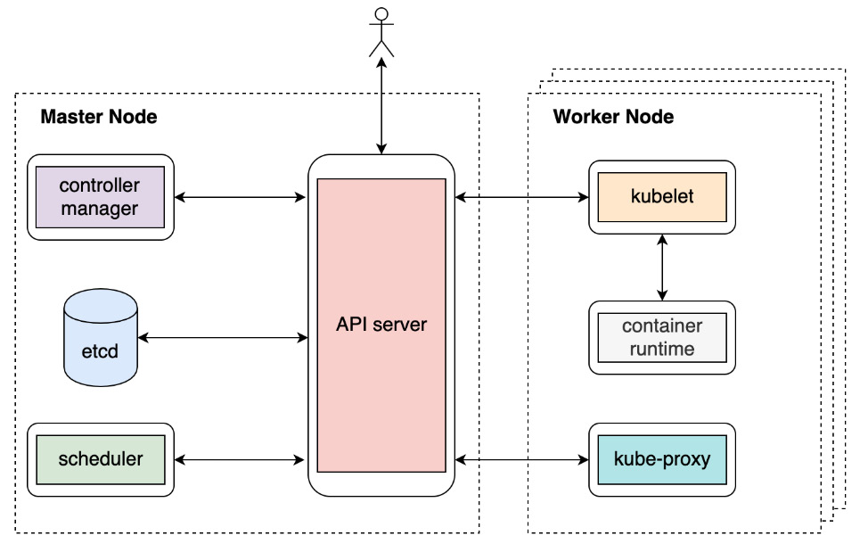
Notes:
API server can talk to almost every other component (except the container runtime, which is handled by the kubelet) and that it also serves to interact with end-users directly.
It turns out that there is no explicit connection among them – the controller manager doesn't talk to the scheduler, nor does the kubelet talk to kube-proxy.
they do need to work in coordination with each other to accomplish many functionalities, but they never directly talk to each other. Instead, they communicate implicitly via the API server.
More precisely, they communicate by watching, creating, updating, or deleting corresponding API objects. This is also known as the controller/operator pattern.

Slide 50
Container Network Interface
There are several networking aspects to take into consideration
How a pod communicates with its host machine's network interface
How a node communicates with other nodes
How a pod communicates with any pod across different nodes
Kubernetes chooses to solve those problems by defining a specification called the Container Network Interface (CNI).
Different CNI providers can follow the same interface and implement their logic that adheres to the Kubernetes standards to ensure that the whole Kubernetes network works.

Slide 51
Build Small App
Create a Cluster
Deploy an App
Explore Your App
Expose Your App Publicly
Scale Your App
Update Your App

Slide 52
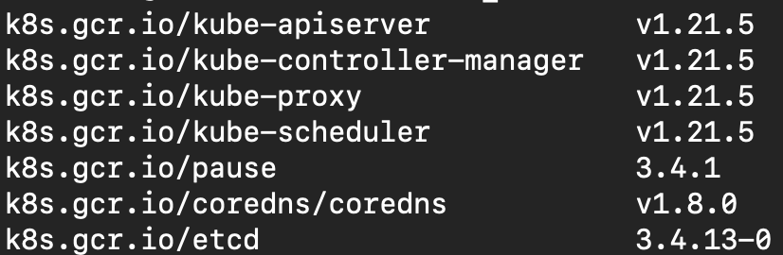
Create A Cluster
Start Docker Desktop
Enable Kubernetes
Run command to check docker image
docker images | greps “k8s”

Slide 53
Deploy an App
Once you have a running Kubernetes cluster, you can deploy your containerized applications on top of it. To do so, you create a Kubernetes Deployment configuration.
The Deployment instructs Kubernetes how to create and update instances of your application
Once you've created a Deployment, the Kubernetes control plane schedules the application instances included in that Deployment to run on individual Nodes in the cluster.
Once the application instances are created, a Kubernetes Deployment Controller continuously monitors those instances.
If the Node hosting an instance goes down or is deleted, the Deployment controller replaces the instance with an instance on another Node in the cluster.
This provides a self-healing mechanism to address machine failure or maintenance.
In a pre-orchestration world, installation scripts would often be used to start applications, but they did not allow recovery from machine failure. By both creating your application instances and keeping them running across Nodes, Kubernetes Deployments provide a fundamentally different approach to application management.

Slide 54
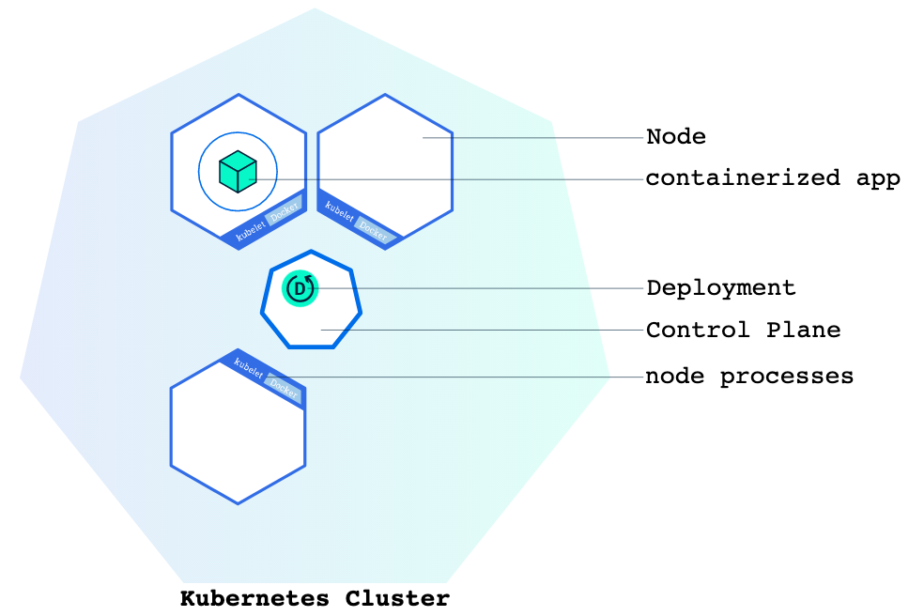
Deploy an App (2)
You can create and manage a Deployment by using the Kubernetes command line interface, Kubectl.
Kubectl uses the Kubernetes API to interact with the cluster.
When you create a Deployment, you'll need to specify the container image for your application and the number of replicas that you want to run

Slide 55
Deploy an App (3)
Create Deployment:
This performed a few things for you:
searched for a suitable node where an instance of the application could be run (we have only 1 available node)
scheduled the application to run on that Node
configured the cluster to reschedule the instance on a new Node when needed
To list your deployments use the get deployments command:
View your app:
Pods that are running inside Kubernetes are running on a private, isolated network.
By default they are visible from other pods and services within the same kubernetes cluster, but not outside that network.
When we use kubectl, we're interacting through an API endpoint to communicate with our application.
The kubectl command can create a proxy that will forward communications into the cluster-wide, private network. The proxy can be terminated by pressing control-C and won't show any output while its running.
kubectl create deployment kubernetes-bootcamp --image=gcr.io/google-samples/kubernetes-bootcamp:v1
kubectl get deployments
kubectl proxy
curl http://localhost:8001/version

Slide 56
Explore Your App
When you created a Deployment, Kubernetes created a Pod to host your application instance.
A Pod is a Kubernetes abstraction that represents a group of one or more application containers (such as Docker), and some shared resources for those containers.
Those resources include:
Shared storage, as Volumes
Networking, as a unique cluster IP address
Information about how to run each container, such as the container image version or specific ports to use
A Pod models an application-specific "logical host" and can contain different application containers which are relatively tightly coupled.
The containers in a Pod share an IP Address and port space, are always co-located and co-scheduled, and run in a shared context on the same Node.
Pods are the atomic unit on the Kubernetes platform.
When we create a Deployment on Kubernetes, that Deployment creates Pods with containers inside them (as opposed to creating containers directly)
Each Pod is tied to the Node where it is scheduled, and remains there until termination (according to restart policy) or deletion. In case of a Node failure, identical Pods are scheduled on other available Nodes in the cluster.
Notes:
For example, a Pod might include both the container with your Node.js app as well as a different container that feeds the data to be published by the Node.js webserver.

Slide 57
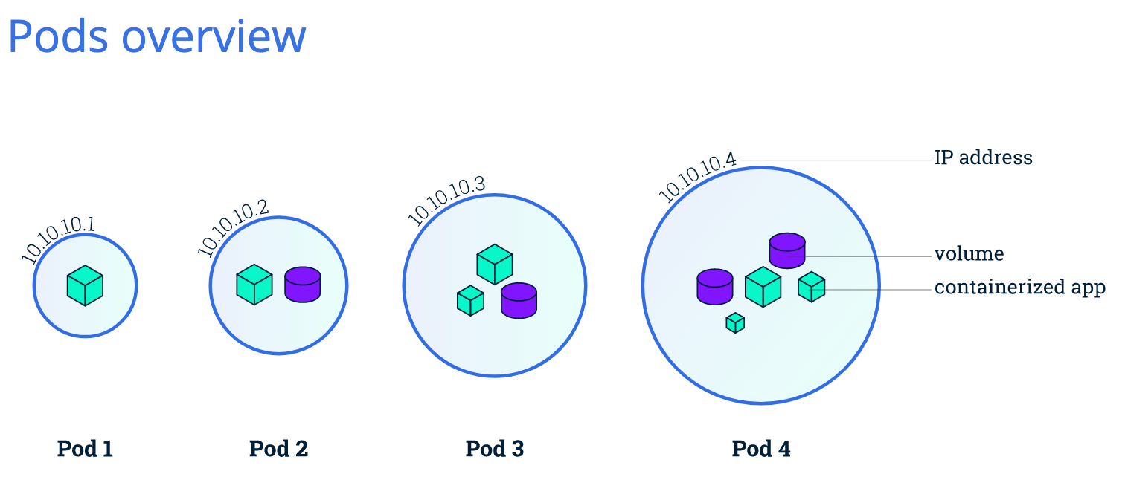
Explore Your App (2)

Slide 58
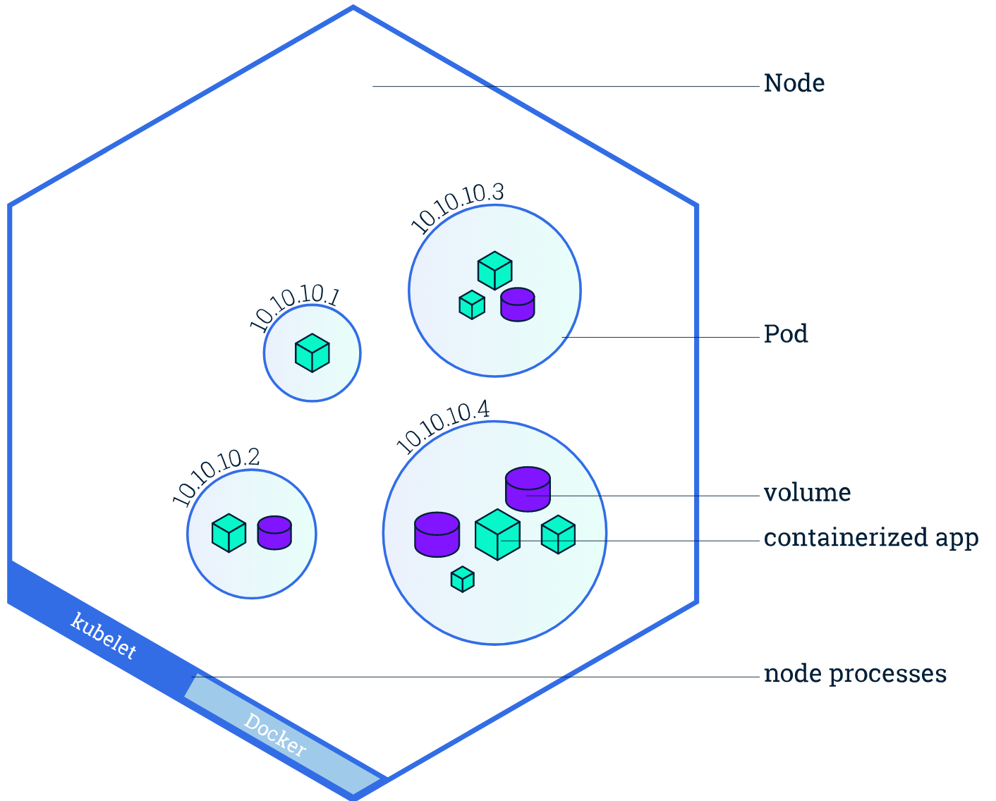
Explore Your App (3)
Nodes
A Pod always runs on a Node
A Node is a worker machine in Kubernetes and may be either a virtual or a physical machine, depending on the cluster.
A Node can have multiple pods, and the Kubernetes control plane automatically handles scheduling the pods across the Nodes in the cluster.
Every Kubernetes Node runs at least:
Kubelet, a process responsible for communication between the Kubernetes control plane and the Node; it manages the Pods and the containers running on a machine.
A container runtime (like Docker) responsible for pulling the container image from a registry, unpacking the container, and running the application.

Slide 59
Explore Your App (4)
Get Pod name
Export to POD_NAME
Run proxy in another tab
To see the output of our application, run a curl request.
View logs of container
Exec command in container
kubectl get pods -o go-template --template '{{range .items}}{{.metadata.name}}{{"\n"}}{{end}}'
export POD_NAME=$(kubectl get pods -o go-template --template '{{range .items}}{{.metadata.name}}{{"\n"}}{{end}}')
kubectl proxy
curl http://localhost:8001/api/v1/namespaces/default/pods/$POD_NAME
kubectl logs $POD_NAME
kubectl exec $POD_NAME -- env

Slide 60
Explore Your App (5)
Go to inside container by bash command
We have now an open console on the container. View source of the app in server.js
You can check that the application is up by running a curl command:
kubectl exec -it $POD_NAME -- bash
cat server.js
curl localhost:8080

Slide 61
Expose Your App Publicly
Overview of Kubernetes Services
Kubernetes Pods are mortal. Pods in fact have a lifecycle. When a worker node dies, the Pods running on the Node are also lost.
A ReplicaSet might then dynamically drive the cluster back to desired state via creation of new Pods to keep your application running.
Each Pod in a Kubernetes cluster has a unique IP address, even Pods on the same Node, so there needs to be a way of automatically reconciling changes among Pods so that your applications continue to function.
A Service in Kubernetes is an abstraction which defines a logical set of Pods and a policy by which to access them. Services enable a loose coupling between dependent Pods. A Service is defined using YAML (preferred) or JSON, like all Kubernetes objects.
The set of Pods targeted by a Service is usually determined by a LabelSelector (see below for why you might want a Service without including selector in the spec).
Although each Pod has a unique IP address, those IPs are not exposed outside the cluster without a Service.
Services allow your applications to receive traffic.
Notes:
As another example, consider an image-processing backend with 3 replicas. Those replicas are exchangeable; the front-end system should not care about backend replicas or even if a Pod is lost and recreated.

Slide 62
Expose Your App Publicly (2)
Services can be exposed in different ways by specifying a type in the ServiceSpec:
ClusterIP (default) - Exposes the Service on an internal IP in the cluster. This type makes the Service only reachable from within the cluster.
NodePort - Exposes the Service on the same port of each selected Node in the cluster using NAT. Makes a Service accessible from outside the cluster using <NodeIP>:<NodePort>. Superset of ClusterIP.
LoadBalancer - Creates an external load balancer in the current cloud (if supported) and assigns a fixed, external IP to the Service. Superset of NodePort.
ExternalName - Maps the Service to the contents of the externalName field (e.g. foo.bar.example.com), by returning a CNAME record with its value. No proxying of any kind is set up. This type requires v1.7 or higher of kube-dns, or CoreDNS version 0.0.8 or higher.
Notes:
As another example, consider an image-processing backend with 3 replicas. Those replicas are exchangeable; the front-end system should not care about backend replicas or even if a Pod is lost and recreated.

Slide 63
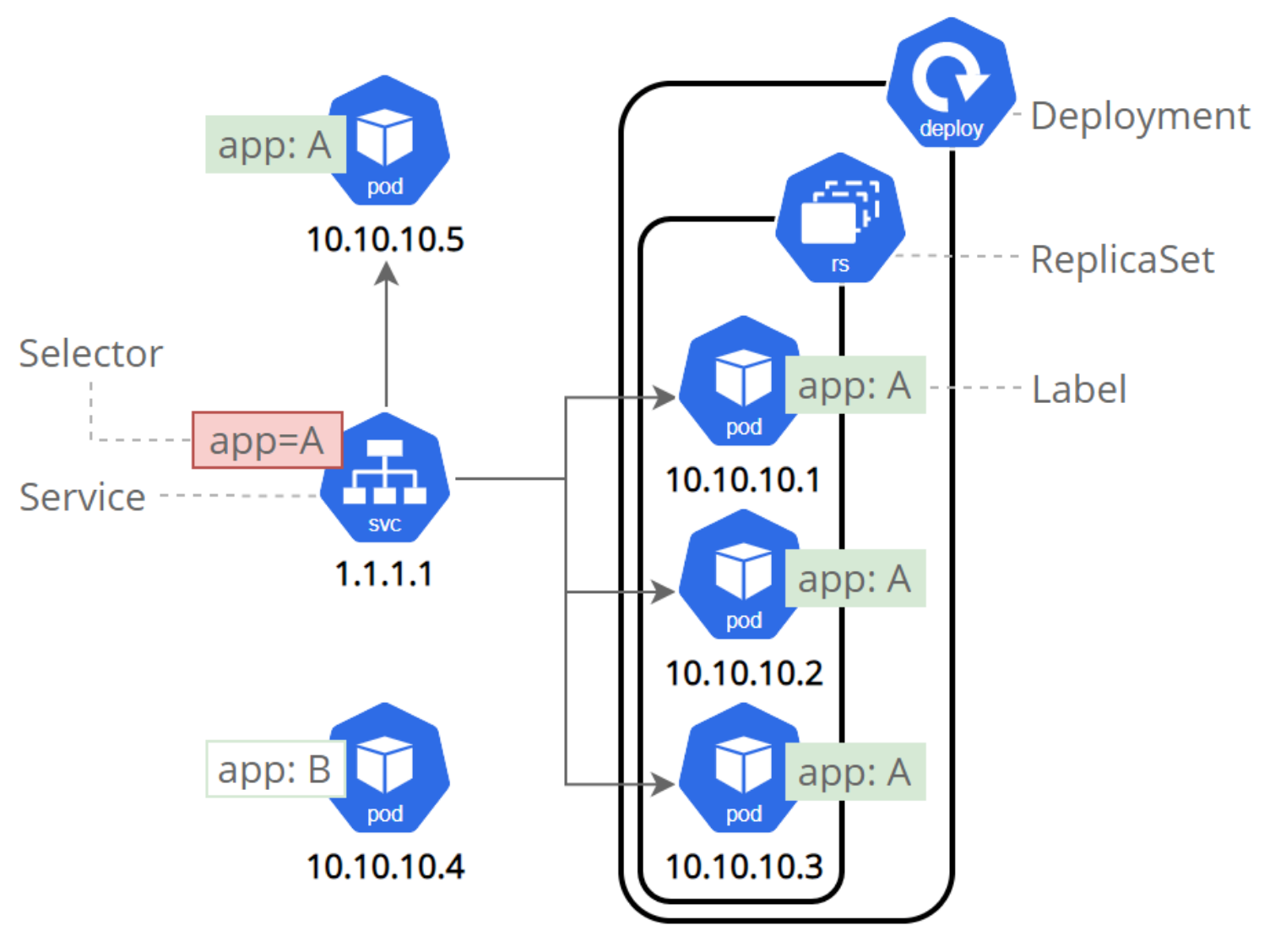
Expose Your App Publicly (3)
Services and Labels
A Service routes traffic across a set of Pods. Services are the abstraction that allows pods to die and replicate in Kubernetes without impacting your application.
Discovery and routing among dependent Pods (such as the frontend and backend components in an application) are handled by Kubernetes Services.
Services match a set of Pods using labels and selectors, a grouping primitive that allows logical operation on objects in Kubernetes. Labels are key/value pairs attached to objects and can be used in any number of ways:
Designate objects for development, test, and production
Embed version tags
Classify an object using tags
Notes:
As another example, consider an image-processing backend with 3 replicas. Those replicas are exchangeable; the front-end system should not care about backend replicas or even if a Pod is lost and recreated.

Slide 64
Expose Your App Publicly (4)
Check list services
We have a Service called kubernetes that is created by default. To create a new service and expose it to external traffic we’ll use the expose command with NodePort as parameter
Create an environment variable called NODE_PORT that has the value of the Node port assigned
Get IP of cluster
kubectl get services
kubectl expose deployment/kubernetes-bootcamp --type="NodePort" --port 8080
kubectl describe services/kubernetes-bootcamp
export NODE_PORT=$(kubectl get services/kubernetes-bootcamp -o go-template='{{(index .spec.ports 0).nodePort}}')
echo NODE_PORT=$NODE_PORT
export CLUSTER_IP=$(kubectl cluster-info | grep "https" | awk 'NR==1{print $(NF)}' | cut -d ':' -f2 | cut -d '/' -f3)
echo CLUSTER_IP=http://$CLUSTER_IP

Slide 65
Expose Your App Publicly (5)
Now we can test that the app is exposed outside of the cluster using curl, the IP of the Node and the externally exposed port:
Get all pods, services with label
Apply new label to pods
Delete services by label
curl $CLUSTER_IP:$NODE_PORT
kubectl get pods -l app=kubernetes-bootcamp
kubectl get services -l app=kubernetes-bootcamp
kubectl label pods $POD_NAME version=v1
kubectl describe pods $POD_NAME
kubectl get pods -l version=v1
kubectl delete service -l app=kubernetes-bootcamp
kubectl get services
curl $CLUSTER_IP:$NODE_PORT
kubectl exec -ti $POD_NAME -- curl localhost:8080

Slide 66
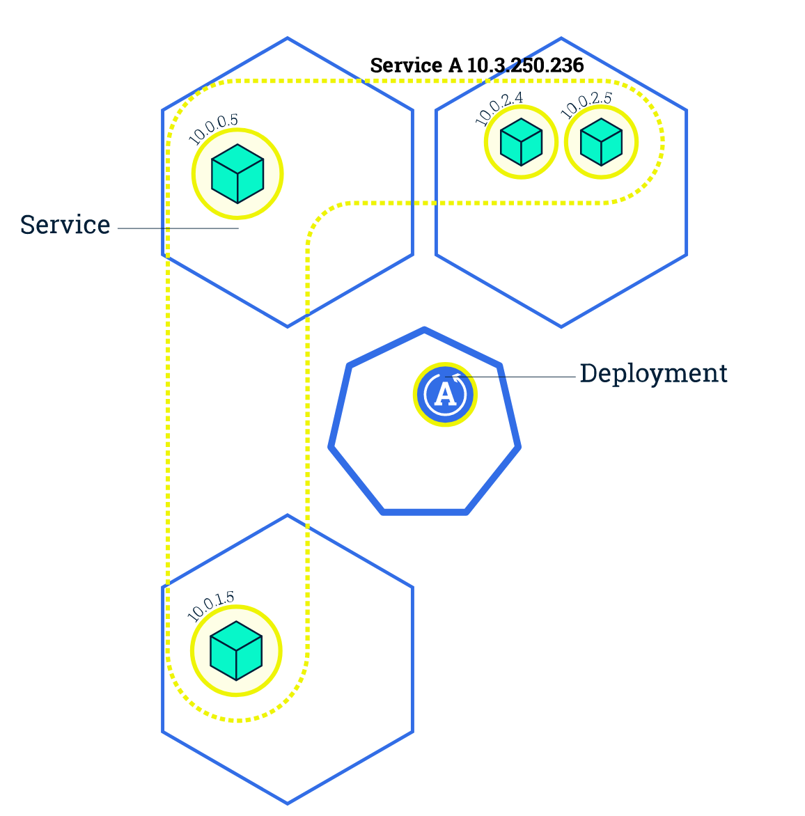
Scale Your App
In the previous modules we created a Deployment, and then exposed it publicly via a Service. The Deployment created only one Pod for running our application. When traffic increases, we will need to scale the application to keep up with user demand.
Scaling is accomplished by changing the number of replicas in a Deployment
Scaling out a Deployment will ensure new Pods are created and scheduled to Nodes with available resources. Scaling will increase the number of Pods to the new desired state.
Once you have multiple instances of an Application running, you would be able to do Rolling updates without downtime.

Slide 67
Scale Your App (2)
List deployments, use the get deployments command (currently only have 1 pod)
To see the ReplicaSet created by the Deployment, run
Let’s scale the Deployment to 4 replicas. We’ll use the kubectl scale command
Build Service again and check expose public
kubectl get deployments
kubectl get rs
kubectl scale deployments/kubernetes-bootcamp --replicas=4
kubectl get deployments
kubectl get pods -o wide
kubectl describe deployments/kubernetes-bootcamp
curl $CLUSTER_IP:$NODE_PORT

Slide 68
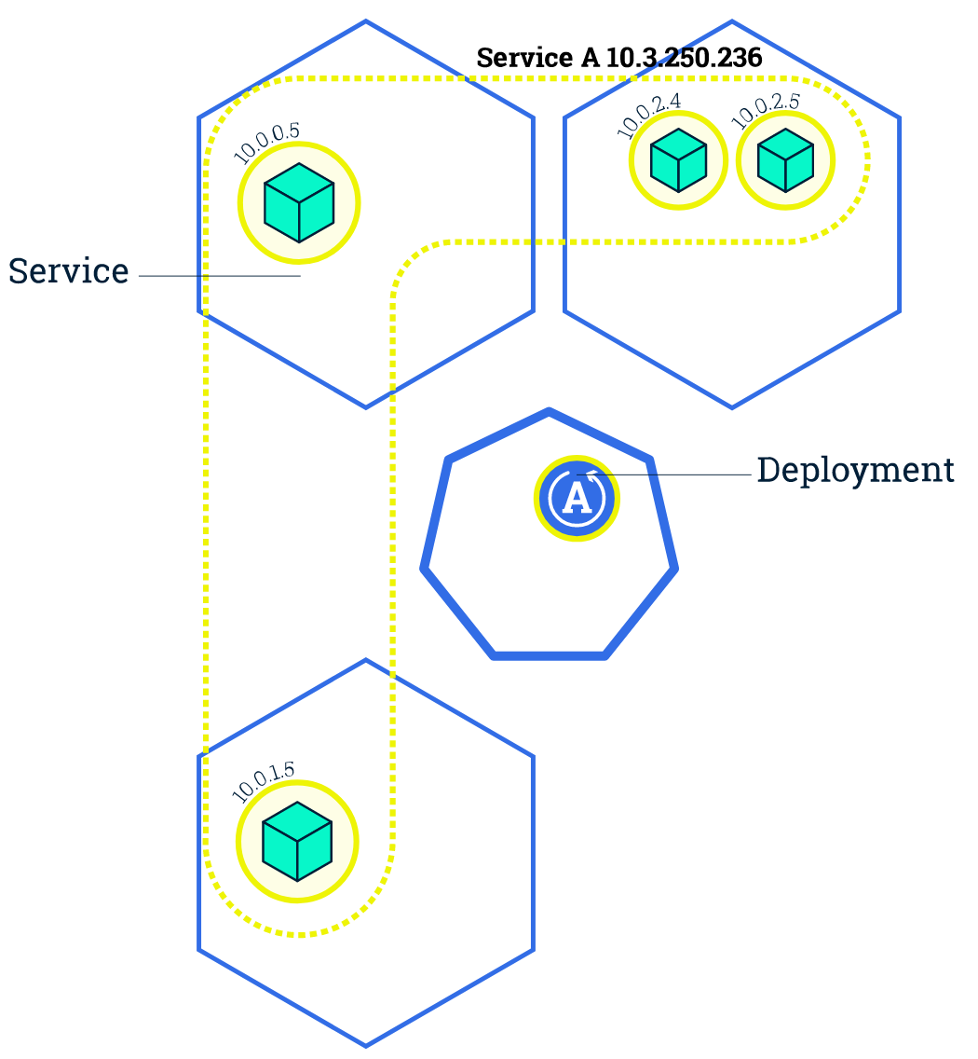
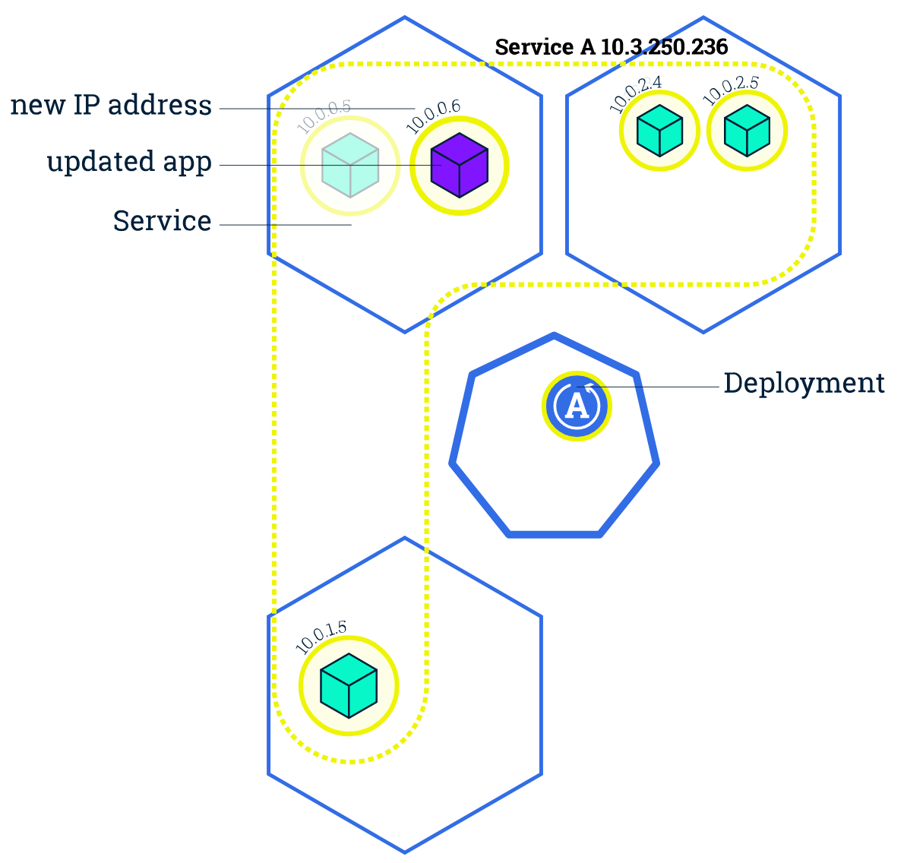
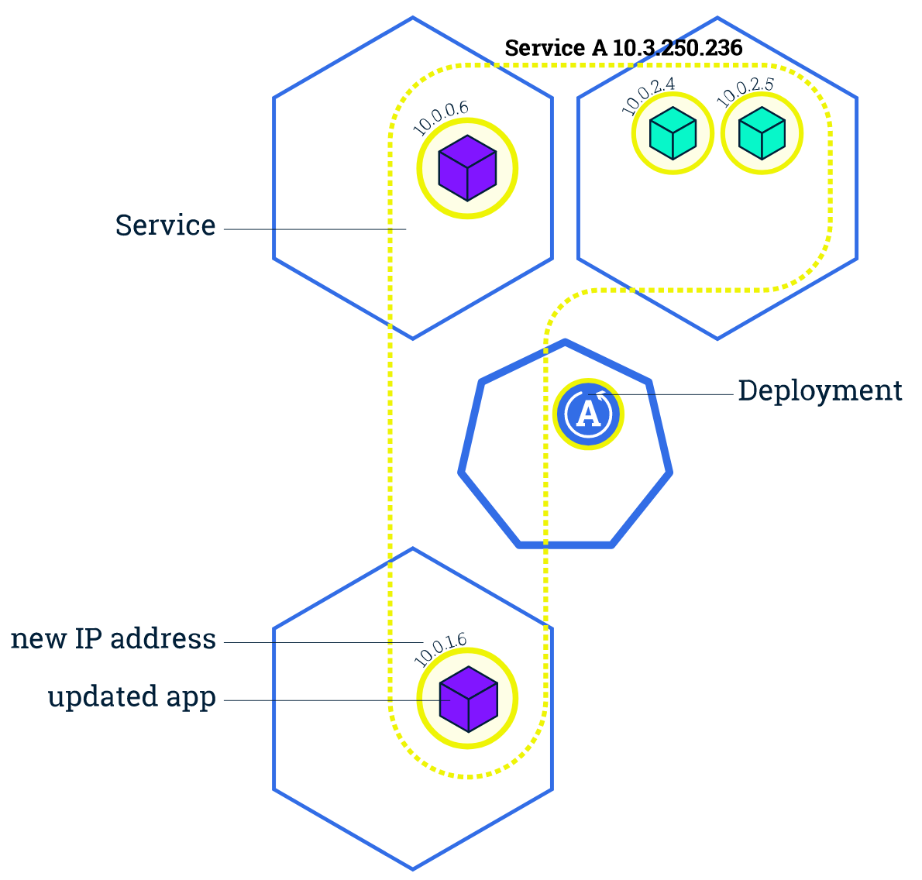
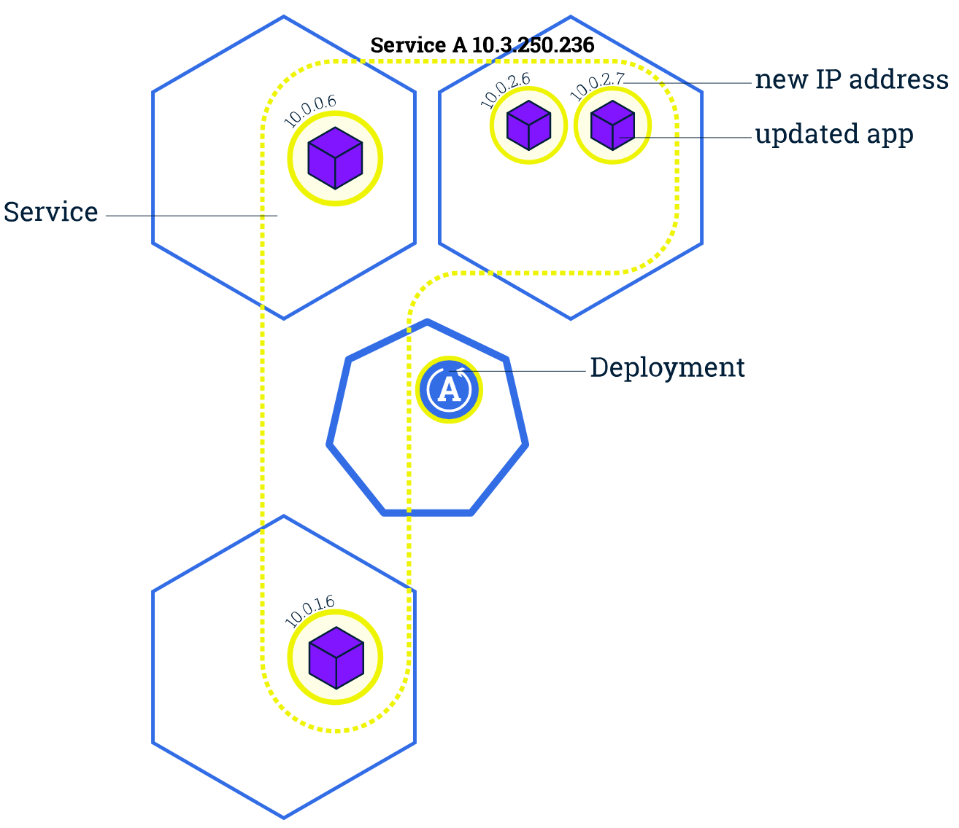
Update Your App
Users expect applications to be available all the time and developers are expected to deploy new versions of them several times a day. In Kubernetes this is done with rolling updates.
Rolling updates allow Deployments' update to take place with zero downtime by incrementally updating Pods instances with new ones. The new Pods will be scheduled on Nodes with available resources.

Slide 69
Update Your App (2)
Similar to application Scaling, if a Deployment is exposed publicly, the Service will load-balance the traffic only to available Pods during the update. An available Pod is an instance that is available to the users of the application.
Rolling updates allow the following actions:
Promote an application from one environment to another (via container image updates)
Rollback to previous versions
Continuous Integration and Continuous Delivery of applications with zero downtime
Update the image of the application to version 2, use the set image command
Check that app running. Find the exposed IP and Port
kubectl set image deployments/kubernetes-bootcamp kubernetes-bootcamp=jocatalin/kubernetes-bootcamp:v2
kubectl get pods -o wide
kubectl describe services/kubernetes-bootcamp

Slide 70
Update Your App (2)
Get NODE_PORT and CLUSTER_IP
Confirm the update by running the rollout status command
To view the current image version of the app, run the describe pods command:
Perform another update, deploy an image tagged with v10:
export NODE_PORT=$(kubectl get services/kubernetes-bootcamp -o go-template='{{(index .spec.ports 0).nodePort}}')
export CLUSTER_IP=$(kubectl cluster-info | grep "https" | awk 'NR==1{print $(NF)}' | cut -d ':' -f2 | cut -d '/' -f3)
curl $CLUSTER_IP:$NODE_PORT
kubectl rollout status deployments/kubernetes-bootcamp
kubectl describe pods
kubectl set image deployments/kubernetes-bootcamp kubernetes-bootcamp=gcr.io/google-samples/kubernetes-bootcamp:v10
kubectl get deployments
kubectl get pods -o wide
kubectl describe pods

Slide 71
Update Your App (2)
In the Events section of the output for the affected Pods, notice that the v10 image version did not exist in the repository.
To roll back the deployment to your last working version, use the rollout undo command:
kubectl rollout undo deployments/kubernetes-bootcamp
kubectl get pods
kubectl describe pods

Slide 72
03
Amazon Elastic Kubernetes Service (EKS)

Slide 73
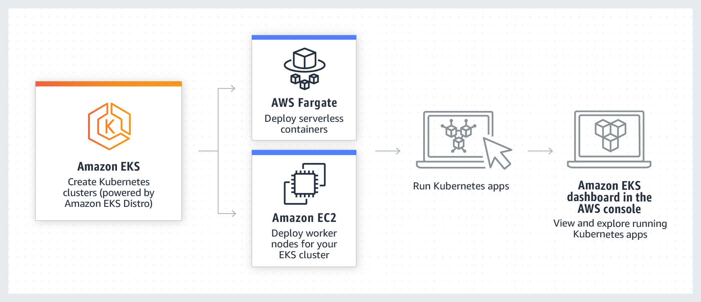

Slide 74
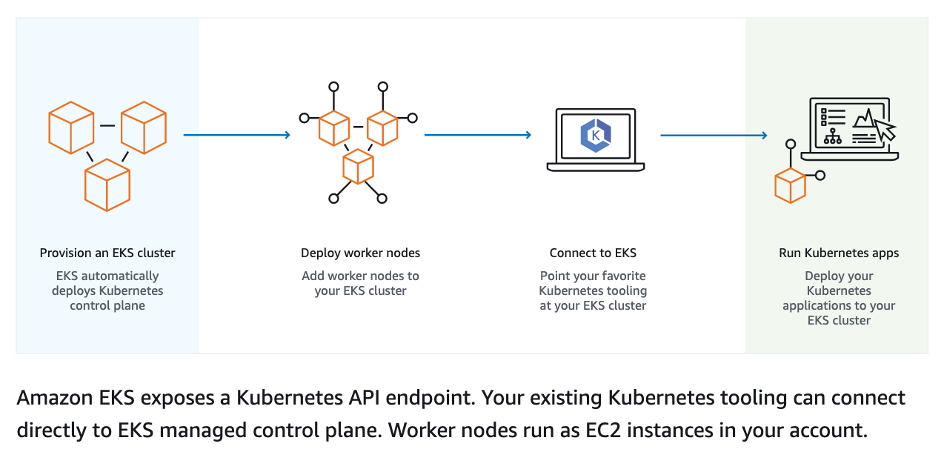
How it works

Slide 75
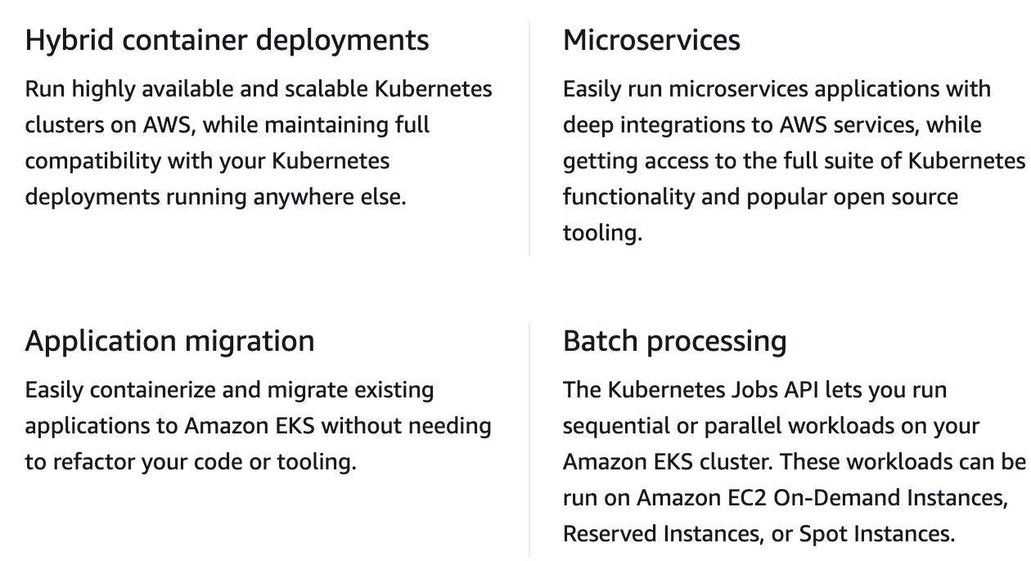
Why use Amazon EKS?

Slide 76
Getting started

Slide 77
Getting started with Amazon EKS
Installing kubectl: https://docs.aws.amazon.com/eks/latest/userguide/install-kubectl.html
Installing eksctl: https://docs.aws.amazon.com/eks/latest/userguide/eksctl.html
Installing aws cli: https://docs.aws.amazon.com/cli/latest/userguide/getting-started-install.html
Configure aws cli work with your Access Key
aws configure: input Access Key ID, Secret Access Key

Slide 78
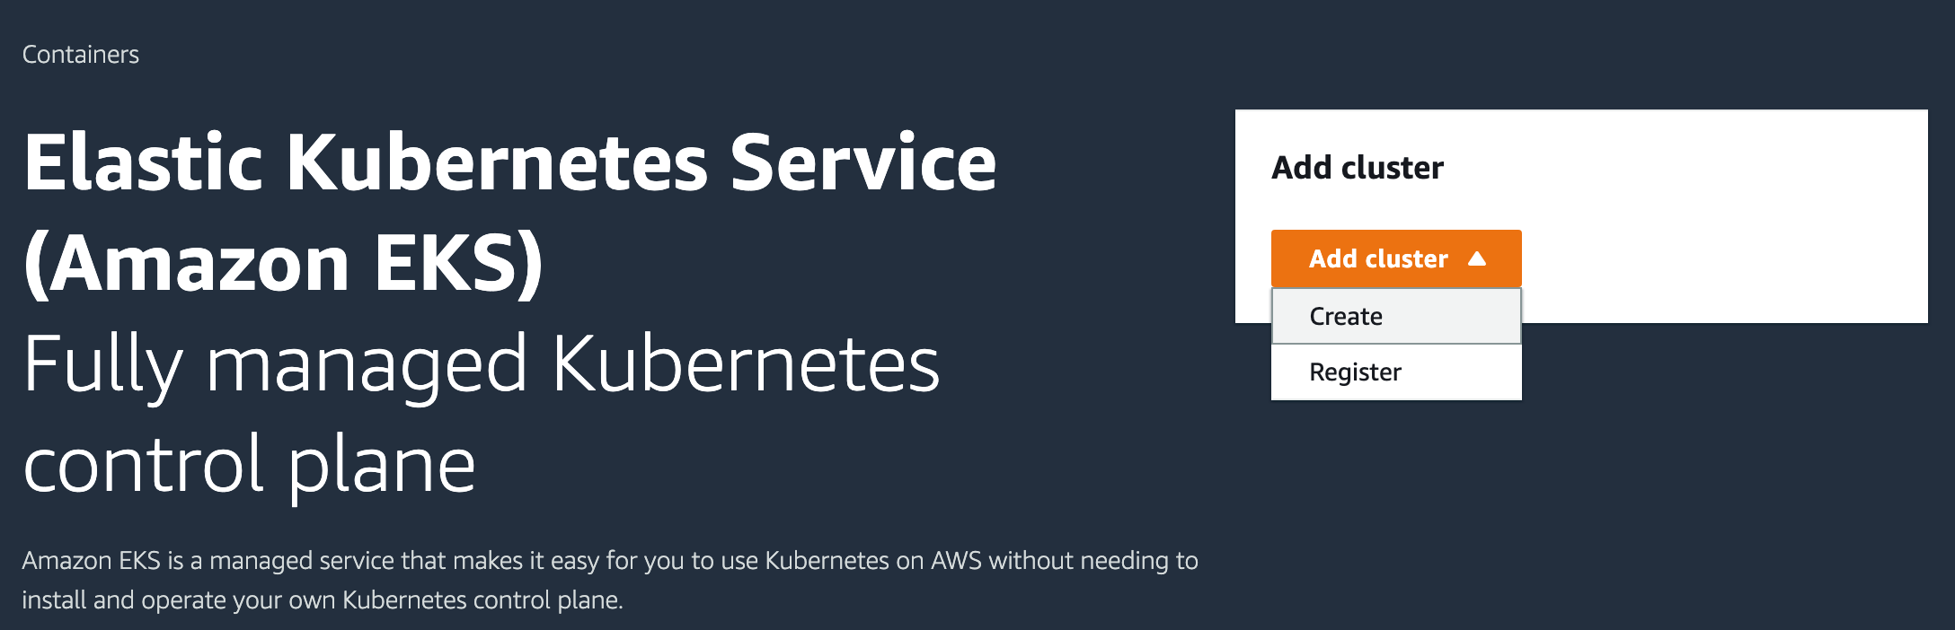
Create your Amazon EKS cluster

Slide 79
Creating the Amazon EKS cluster role
To create your Amazon EKS cluster role in the IAM console
Open the IAM console at https://console.aws.amazon.com/iam/.
Choose Roles, then Create role.
Under Trusted entity type, select AWS service.
From the Use cases for other AWS services dropdown list, choose EKS.
Choose EKS - Cluster for your use case, and then choose Next.
On the Add permissions tab, choose Next.
For Role name, enter a unique name for your role, such as eksClusterRole.
For Description, enter descriptive text such as Amazon EKS - Cluster role.
Choose Create role.

Slide 80
Thank you

